Slide 1
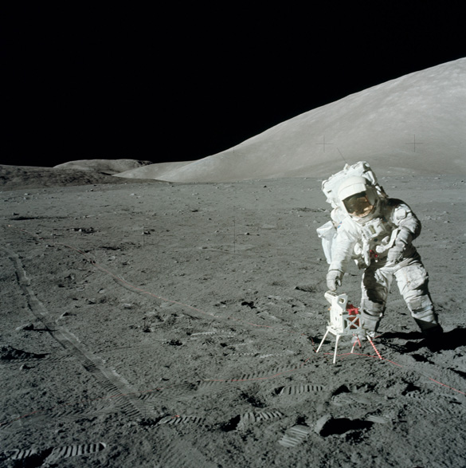

The Earth’s Moon
National Aeronautics and Space Administration
Notes:
THE MOON: GEOLOGIC HISTORY
(All slides are from NASA, except where noted.)

Slide 2
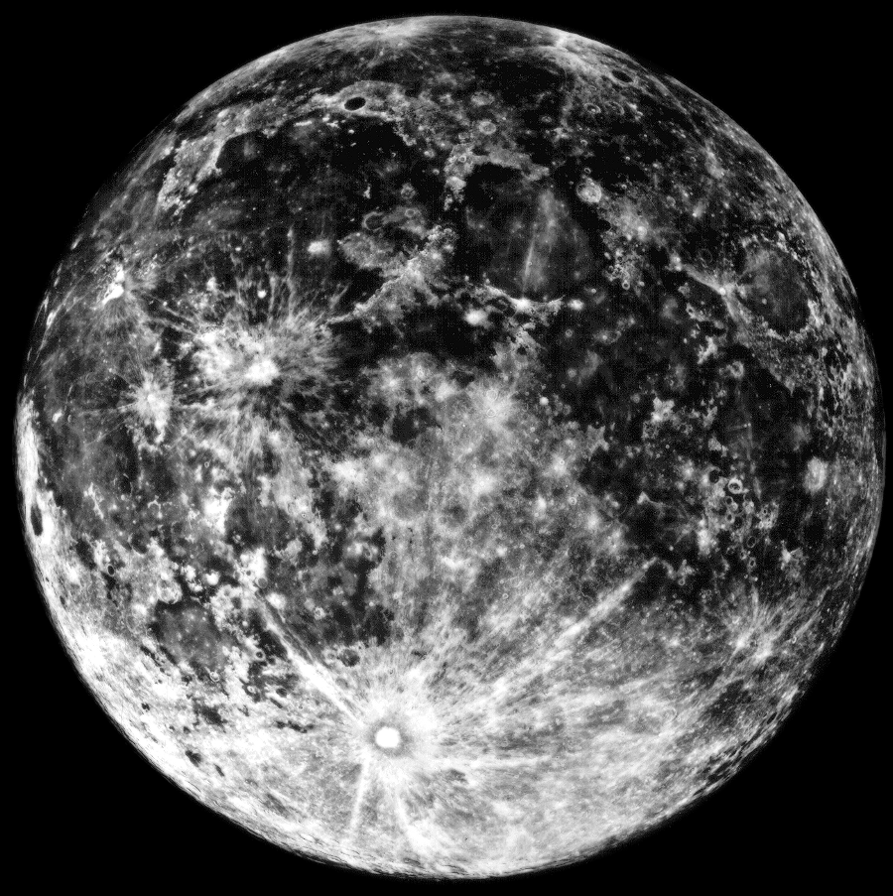
What We Knew About The Moon Before Apollo
https://ares.jsc.nasa.gov/interaction/lmdp/
Image Credits: Link Observatory, Copyright UC
Regents; used with permission
Notes:
This picture of the Moon was taken with a telescope at Lick Observatory, California. Before rockets streaked to the Moon, scientists knew that the Moon had two major types of terrain. The lighter terrain, called the highlands, is more heavily cratered and older than the darker, smoother maria a latin word meaning seas.” Many of the mountains in the highlands form large circles, called multi-ringed basins. The basins were thought by almost all scientists to have been made when large objects crashed into the Moon. (Link Observatory Photo, Copyright UC Regents; used with permission.)
ADD KENNEDY SPEECH LINK????

Slide 3
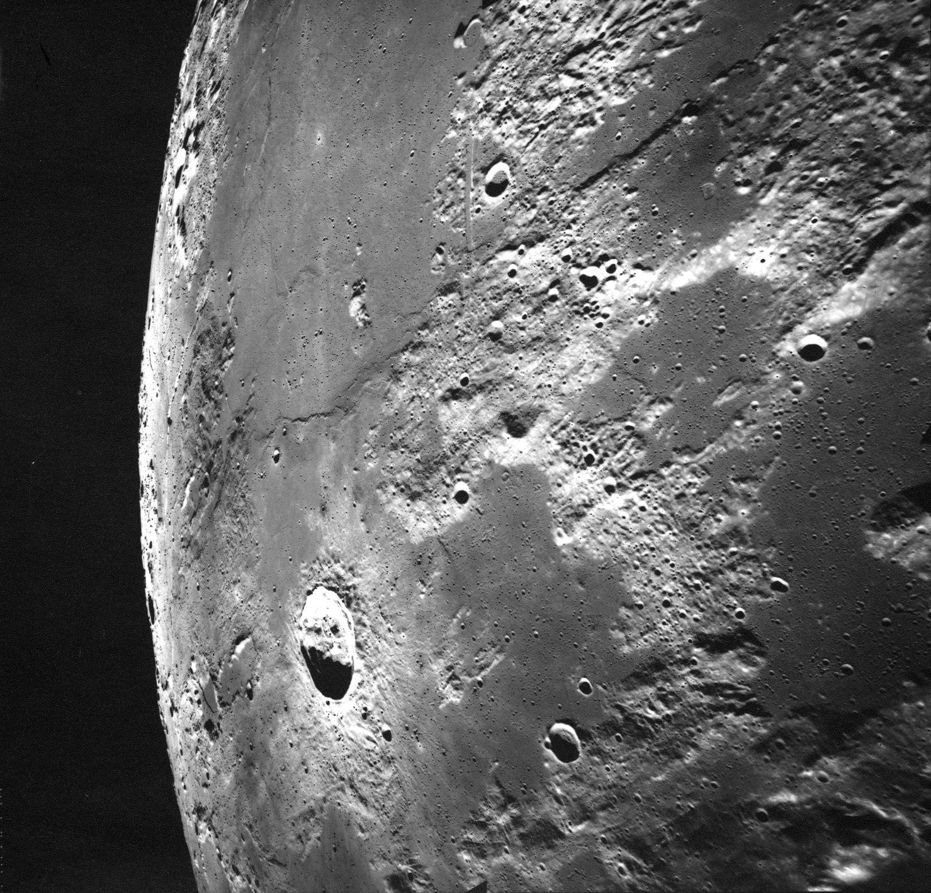
View Seen By Apollo 17
https://ares.jsc.nasa.gov/interaction/lmdp/
Image Credits: NASA AS17-M-1671
Notes:
This is a view seen by Apollo 17 astronauts as they orbited the Moon. The maria are smoother, lower, and darker than the highlands. The crater in the upper left is 20 kilometers across. (AS17-M-1671)

Slide 4
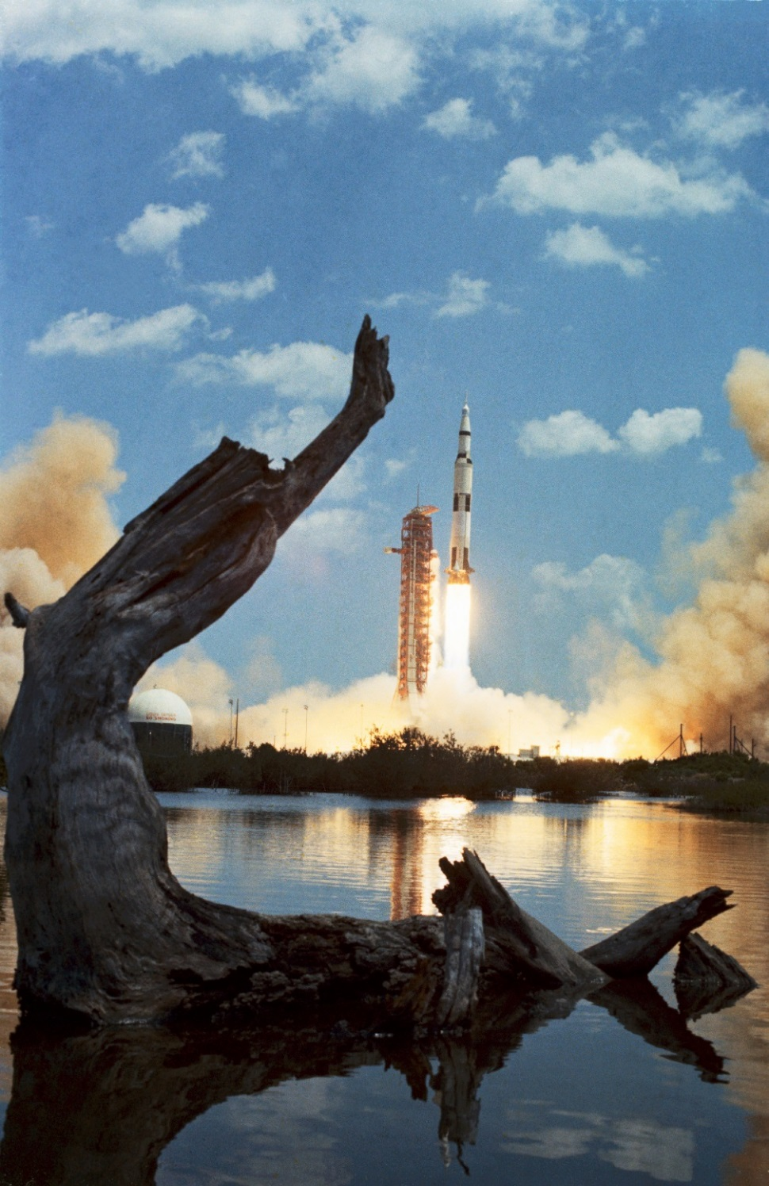
Apollo Missions
https://ares.jsc.nasa.gov/interaction/lmdp/
Image Credits: NASA S72-35347
Notes:
Our knowledge increased dramatically beginning in 1969 when people rode great rocket ships to the Moon. This shows the launch in 1972 of the Apollo 16 mission to the landing site in the highlands of the Moon. In all, there were six Apollo landings to the Moon. In each case two astronauts descended to the Moon’s surface while a third remained in orbit around the Moon in the main spacecraft called the Command and Service Module. (S72-35347)
The Apollo mission (1969-1972) collected 382 Kilograms (842 Pounds.) of rock, soil, and core samples from 6 different locations on the Moon. These are the only samples collected by astronauts. Even now, hundreds of samples are sent to scientists all over for research and study.

Slide 5
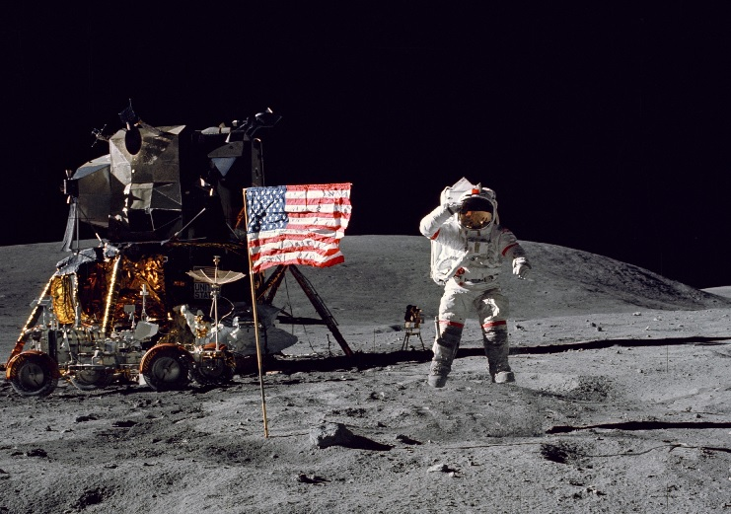
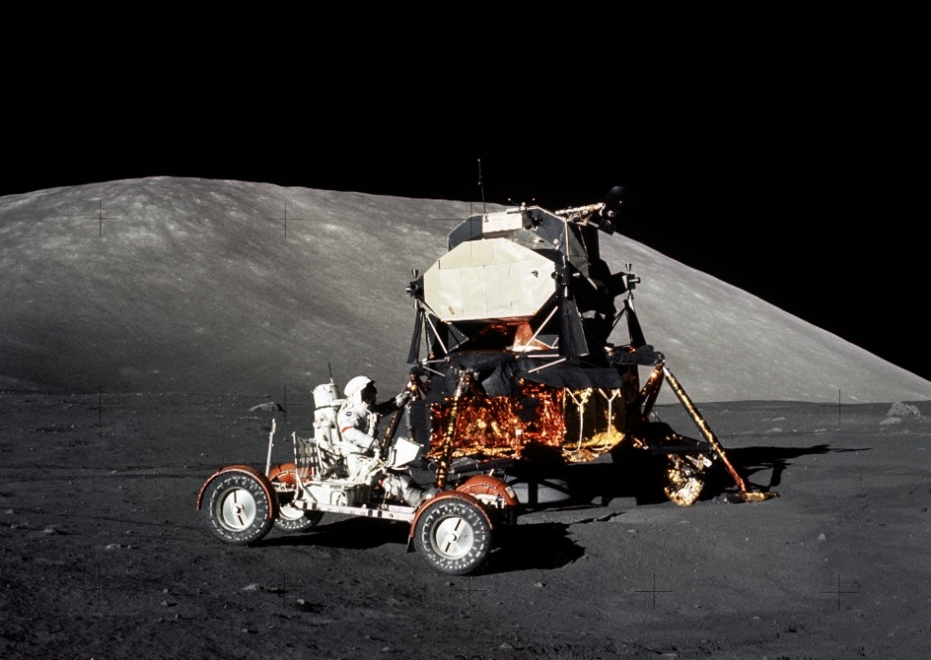
https://ares.jsc.nasa.gov/interaction/lmdp/
Image Credits: NASA AS16-113-18339
NASA AS17-147-22527
Notes:
(Top photo) John Young, Commander of the Apollo 16 mission saluting the flag. The Lunar Module is behind Young, with the Lunar Roving Vehicle parked next to it. This picture shows several interesting features about the Moon. First, Commander Young is wearing a space suit. There is no air on the Moon, so astronauts must bring their life support systems with them. Notice that he has jumped about a meter off the ground, in spite of wearing the bulky space suit. In fact, Young and his extraterrestrial outfit weighed 150 Kilograms on Earth. If gravity was the same on the Moon, nobody could jump so far off the ground! Also notice that there are no trees or bushes in sight, and the astronauts did not set up camp next to a babbling mountain stream. There is no life or flowing water on the Moon. (AS16-113-18339)
(Bottom photo) Astronaut Harrison Schmitt driving the lunar dune buggy, officially called the Lunar Roving Vehicle, or LRV for short. The rover greatly enhanced Lunar exploration on the last three Apollo missions by allowing much longer traverses around the landing sites. (AS17-147-22527)

Slide 6
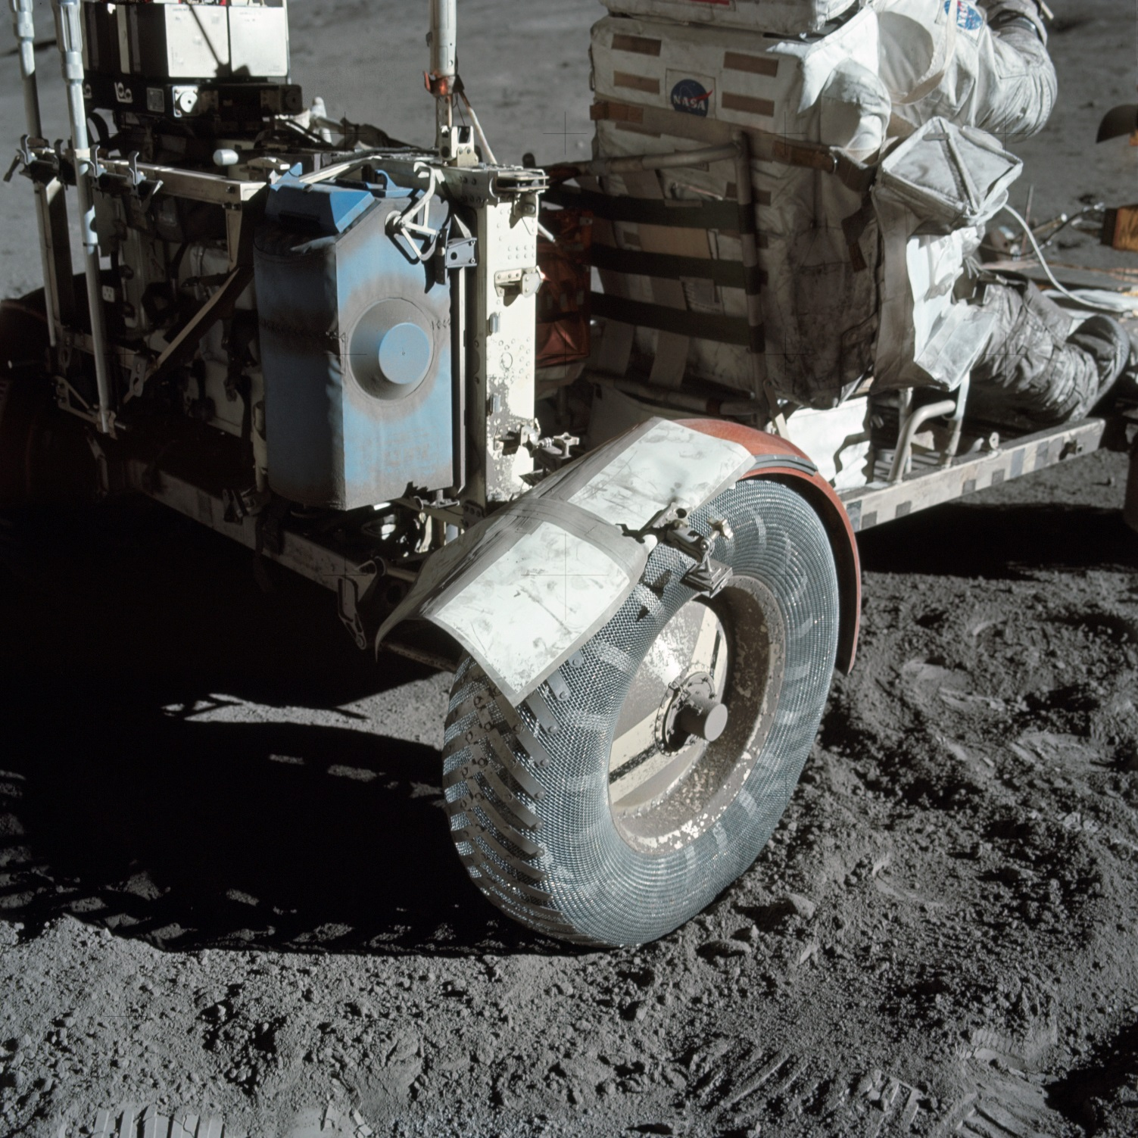
https://ares.jsc.nasa.gov/interaction/lmdp/
Image Credits: NASA AS17-137-20979
Notes:
One of the great advantages people have over robots is their wonderful ability to solve problems. This slide shows how the Apollo 17 astronauts repaired a broken fender on their rover by using a map and duct tape. Without a fender, dust was being thrown both forwards and backwards, interfering with driving. (AS17-137-20979)

Slide 7
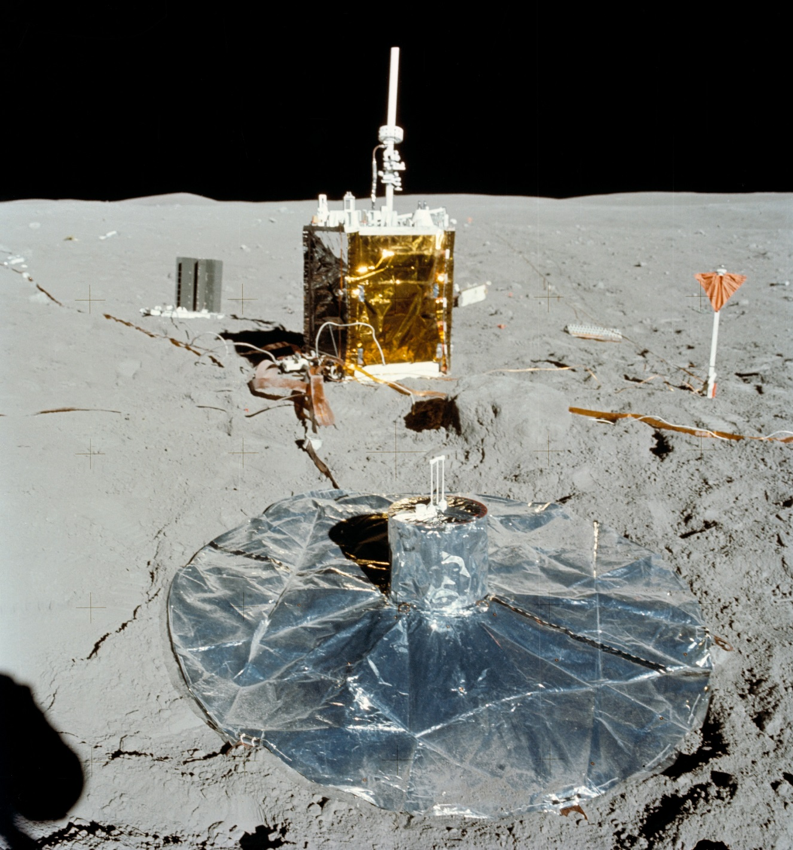
Astronaut Experiments On The Lunar Surface
https://ares.jsc.nasa.gov/interaction/lmdp/
Image Credits: NASA AS16-113-18347
Notes:
Many geophysical instruments were deployed on the Moon’s surface. Each Apollo mission brought an array of scientific instruments with it. They measured the composition of the very tenuous atmosphere, the strength of the magnetic field, and the nature of the interior. The large object in the center of the slide is the central station which sent data back to Earth. The smaller, dark object to the left of the central station is the power supply needed to run the experiments (it used isotopes of plutonium), and the shiny object in the foreground is a seismometer which detected moonquakes. (AS16-113-18347)

Slide 8
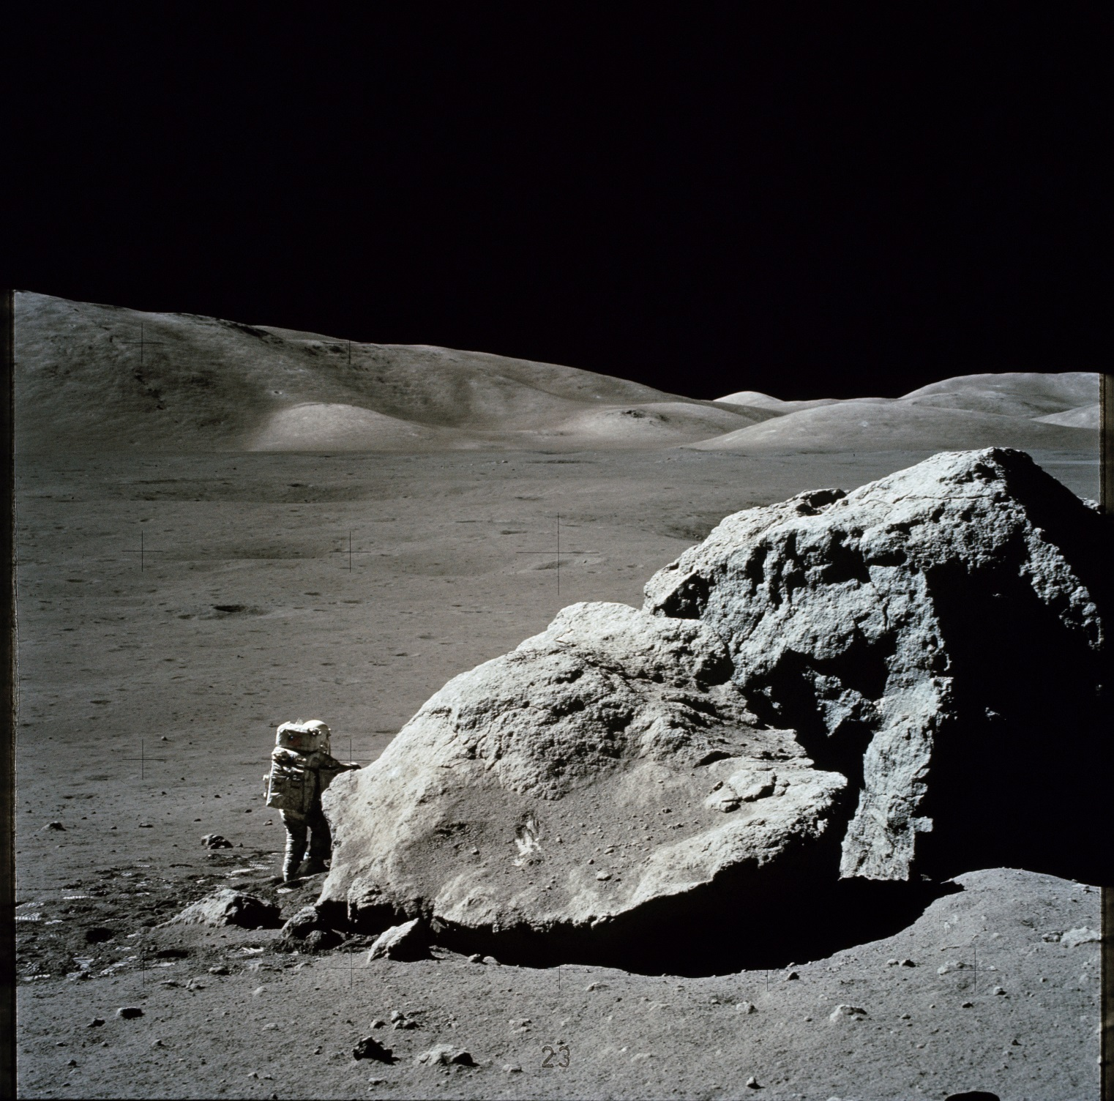
Lunar Geology
https://ares.jsc.nasa.gov/interaction/lmdp/
Image Credits: NASA AS17-140-21497
Notes:
Harrison Schmitt examines a boulder at the Apollo 17 landing site. Geology is more than picking up rocks or whacking them with a hammer. Geologists want to know how different rock types relate to each other. So, Schmitt and other astronauts examined large boulders carefully, sampling rocks from discernible layers. They also tried to see where the boulders came from. In this case, the large rock rolled down from the top of a nearby hill. (AS17-140-21497)

Slide 9
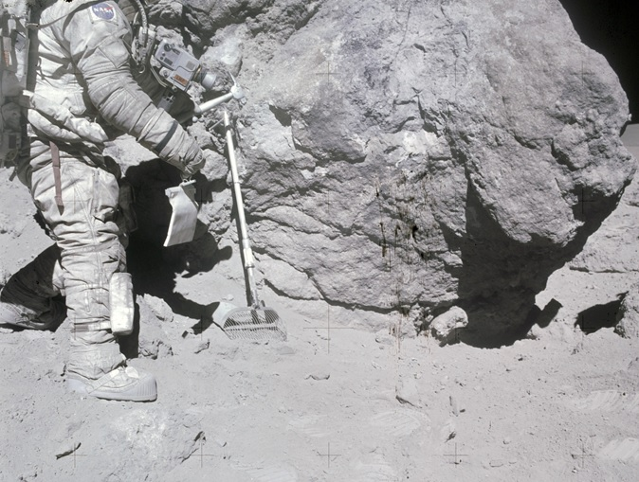
Lunar Tools
https://ares.jsc.nasa.gov/interaction/lmdp/
Image Credits: NASA AS16-116-18653
Notes:
This slide shows an astronaut collecting walnut-sized rocks with a rake. The samples, aptly named “rake samples,” proved to be extremely valuable because they provided a broad sampling of rock types present at a landing site. Some rock types were present only among rake samples. Also note the nature of the Lunar surface. It is mostly powdery, with rock distributed throughout it. (AS16-116-18653)

Slide 10
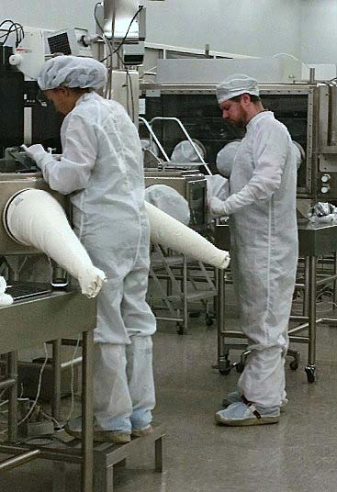
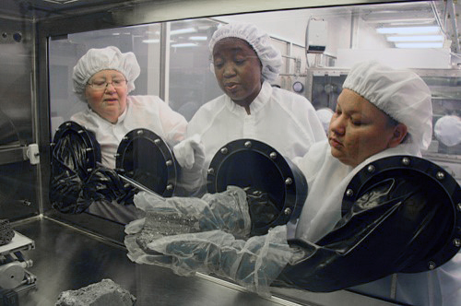
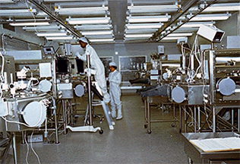
Caring For The Samples On Earth
Image Credits: NASA S80-29345
NASA JSC
https://ares.jsc.nasa.gov/interaction/lmdp/
Notes:
NASA stores Lunar samples that are in pristine condition in the Lunar Curatorial Facility at the Johnson Space Center in Houston, Texas. The samples remain in the glass and stainless steel cabinets, bathed in an atmosphere of Nitrogen, which is relatively inert, so the samples are not altered by reaction with air. (S80-29345)
For more information and a virtual tour go to : http://curator.jsc.nasa.gov/lunar/lun-fac.cfm
Upper right- two Lunar Processors examine samples in the glovebox. Lower left- Lunar Processors examine samples from Apollo missions. Lower right- Lunar Processors working in the Lunar Lab.

Slide 11
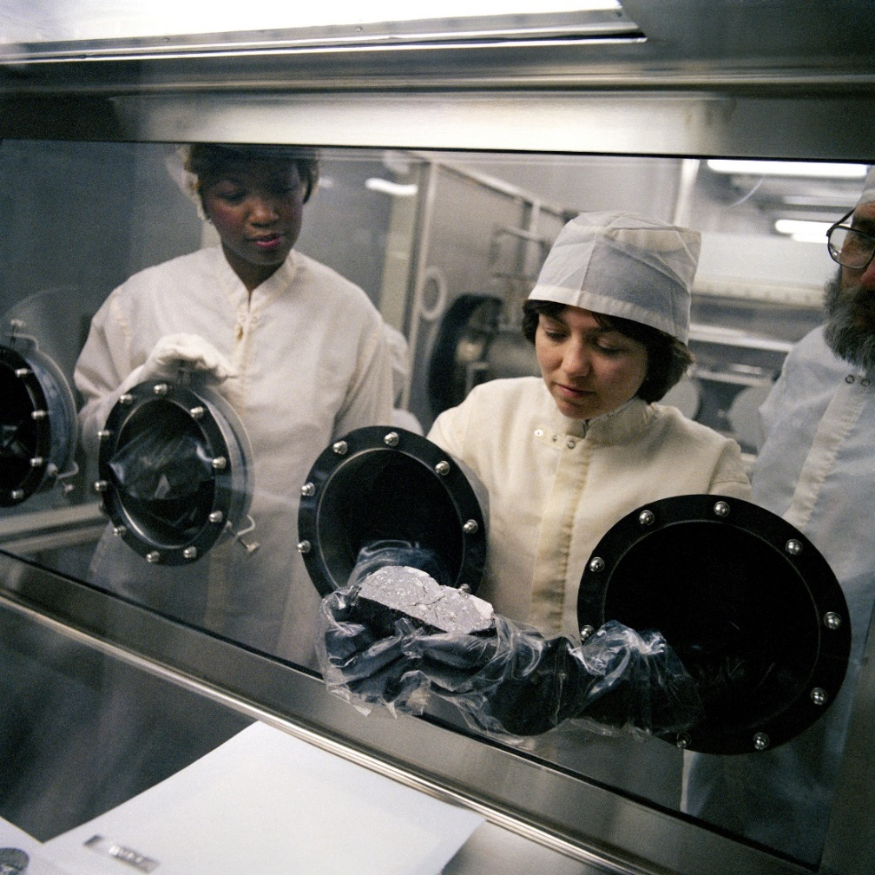
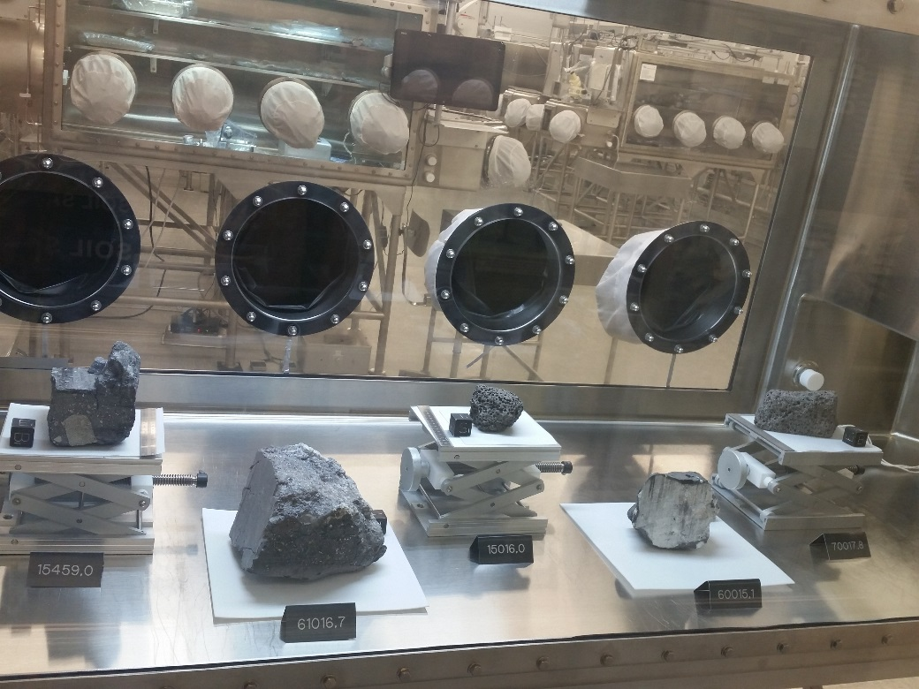
https://ares.jsc.nasa.gov/interaction/lmdp/
Image Credits: NASA JSC
NASA S82-26777
Notes:
The skilled technicians, called Lunar Processors, who curate the Lunar Samples wear lint-free suits (called bunny suits) for cleanliness. The Lunar Processors actually never handle the samples directly. Instead, they pick up the rocks by using the black rubber Neoprene gloves that protrude from the cabinets. These black gloves also have a second glove made of Teflon placed over it before touching the samples. The Lunar Processor already have a pair of gloves on their hands, so that is three pairs of gloves on before they pick up a sample! This protects the rocks from being contaminated. (S82-26777) Image on the Left- Apollo samples. Image on the right- Lunar Processors examine one of the Apollo samples.

Slide 12
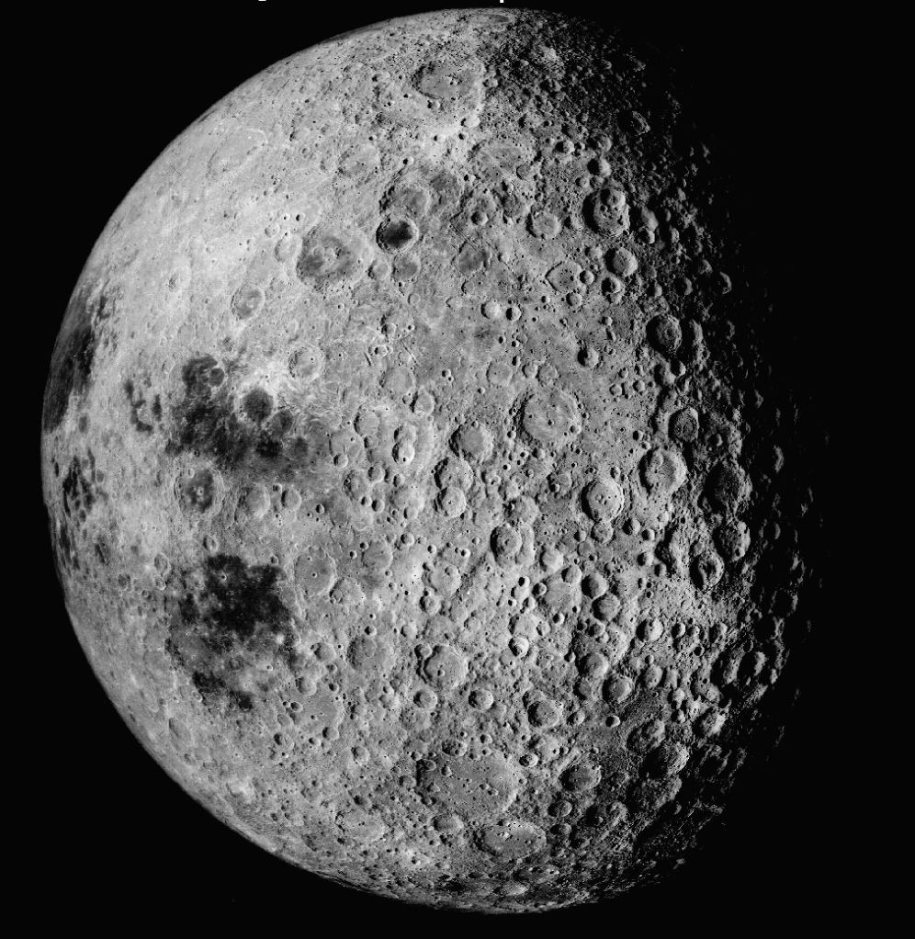
Far Side Of The Moon
https://ares.jsc.nasa.gov/interaction/lmdp/
Image Credits: NASA AS16-M-3021
Notes:
This is a view of the farside of the Moon. The dark maria on the left are barely visible from Earth. All the terrain to the right is on the far side and was completely unexplored until the space age. The highlands are lighter in color than the maria, higher by a few kilometers on average, and intensely cratered. (AS16-M-3021)

Slide 13
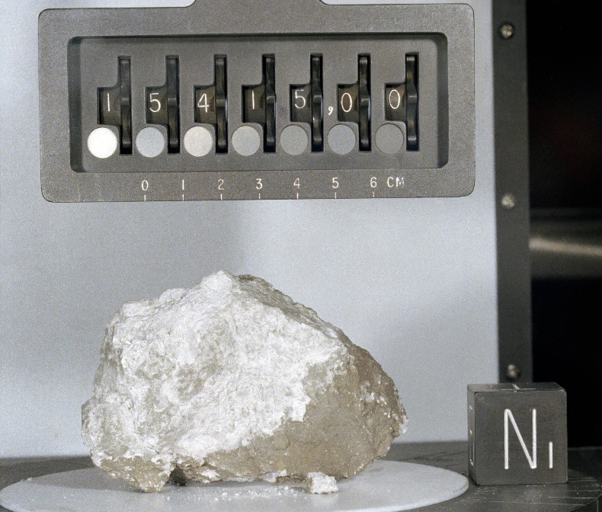
Anorthosite
Image Credits: NASA S71-42951
https://ares.jsc.nasa.gov/interaction/lmdp/
Notes:
There are three abundant types of rock on the moon; anorthosite, breccia and basalt. This is a sample of anorthosite returned by the Apollo 15 mission. Anorthosites are composed almost entirely of one mineral, Anorthite (a type of plagioclase feldspar). One way a single-mineral rock forms is by accumulation by either floating or sinking in a magma. Because anorthosite seems to be an abundant and widespread rock type in the lunar highlands, scientists believe that the Moon was surrounded completely by a huge ocean of magma soon after it formed. (S71-42951)

Slide 14
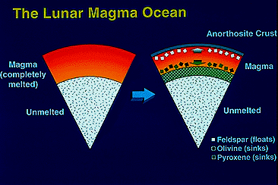
https://ares.jsc.nasa.gov/interaction/lmdp
Image Credits: Graphics by Brooks, Bays,
University of Hawaii
Notes:
This diagram depicts the magma ocean concept. When the Moon formed it was enveloped by a layer of molten rock (magma) hundreds of kilometers deep. As a magma crystallized, the minerals more dense than the magma sank while those less dense (such as feldspar) floated, forming the anorthosite crust. The dense minerals (olivine and pyroxene) later remelted to produce the basalts that compose the maria. (Graphics by Brooks Bays, University of Hawaii.)

Slide 15
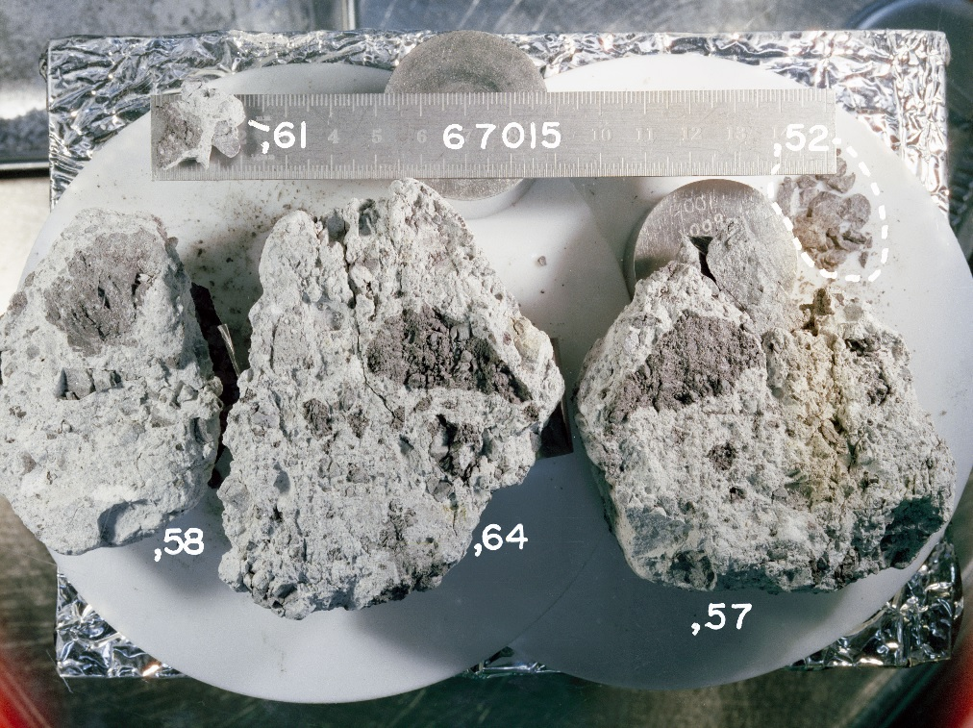
Breccia
https://ares.jsc.nasa.gov/interaction/lmdp/
Image Credits: NASA S75-32669
Notes:
With so many craters of all sizes in the Lunar highlands, it is no wonder that the rocks have been modified by Meteorite impact. This sample was collected by the Apollo 16 mission. It is a collection of rock and dust fragments all mixed together. Geologists call such rocks “breccias.” Many of the rock fragments are themselves breccias, some, such as the dark fragments, were even melted by an impact. (S75-32669)

Slide 16
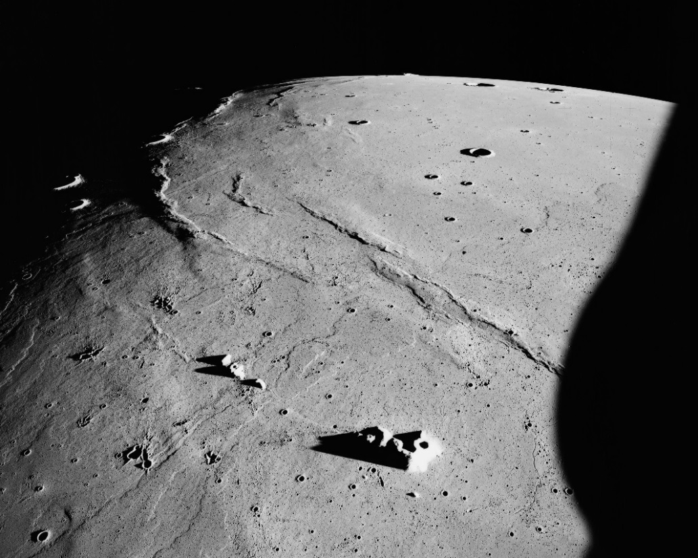
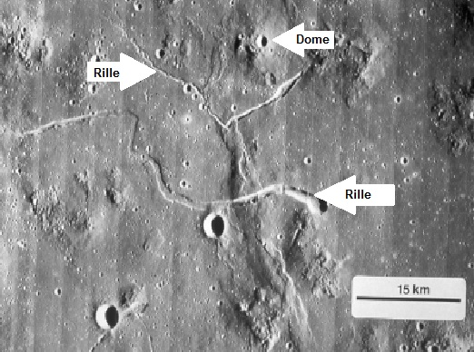
Lava Flows
Image Credits: NASA AS15-M-1556
NASA Lunar Orbiter V-214-M
https://ares.jsc.nasa.gov/interaction/lmdp/
Notes:
The top right picture taken during the Apollo 15 mission shows lava flows in Mare Imbrium. The prominent lava flows that extend from lower left to upper right in this slide are among the youngest on the Moon, a mere 2.5 billion years old! These flows are several hundred kilometers long.
(AS15-M-1556)
The bottom left- Although eruption of most mare basalts did not produce volcanic mountains, there are small volcanic domes in a few places. This shows the Marius Hills, a collection of relatively low domes. The river-like feature in this photograph is called “rille.”
Rilles (sinuous lava channels) are also visible, one of which cuts across a mare ridge. (Lunar Orbiter V-214-M)

Slide 17
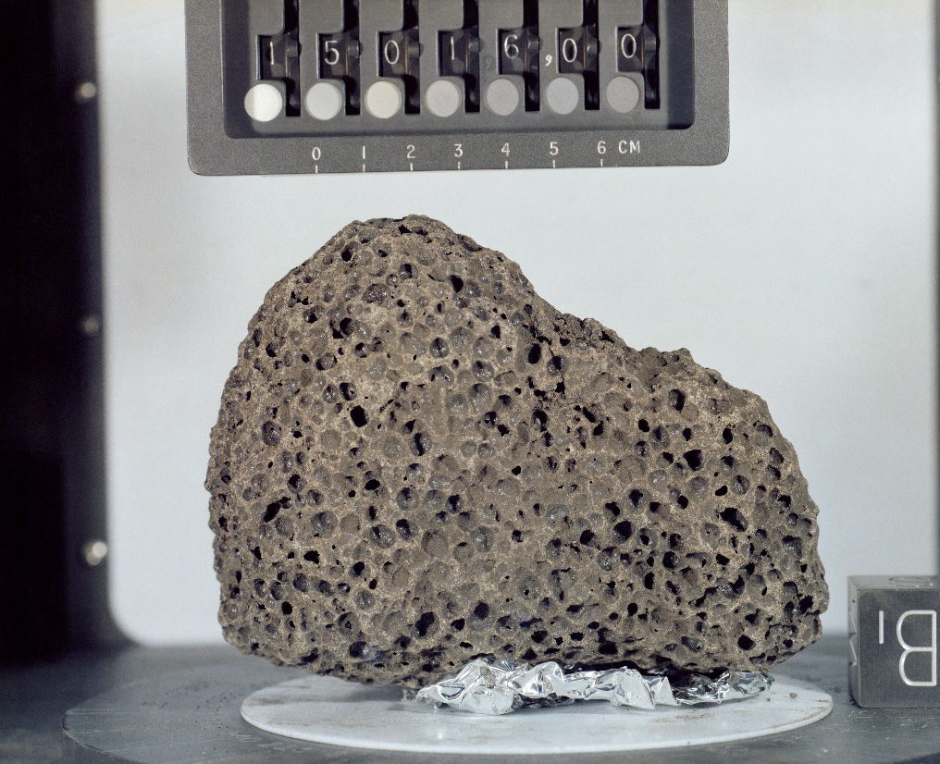
Basalt
https://ares.jsc.nasa.gov/interaction/lmdp/
Image Credits: NASA S71-46632
Notes:
This is a basalt sample returned by the Apollo 15 mission. The brownish color is caused mostly by the presence of the mineral pyroxene. The holes are frozen gas bubbles called “vesicles”, a common feature of terrestrial volcanic rocks. (S71-46632)

Slide 18
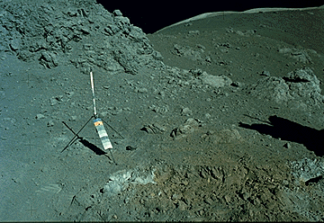
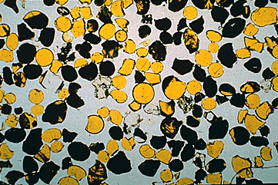
Orange Soil
Image Credits: (top)NASA As17-137-20990
(bottom left) Photo courtesy of Graham Ryder,
Lunar and Planetary Institute
https://ares.jsc.nasa.gov/interaction/lmdp/
Notes:
Top right- Astronauts found a pyroclastic deposit on the Moon at the Apollo 17 landing site. The orange soil is composed of numerous droplets of orange glass that formed by fire fountaining. (AS17-137-20990)
Bottom left- Thin slice of some Apollo 17 orange soil. This view is 2.5 millimeters across. The small drops of lava did not have time to form minerals in it before it cooled, so most of the droplets are composed of glass. The darker ones did have time to crystallize partially, and formed the mineral Ilmenite, which is opaque, and so appears black in this photograph. (Photography courtesy of Graham Ryder, Lunar and Planetary Institute.)
For more information and video visit: http://www.history.nasa.gov/alsj/a17/a17.sta4.html

Slide 19
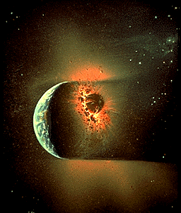
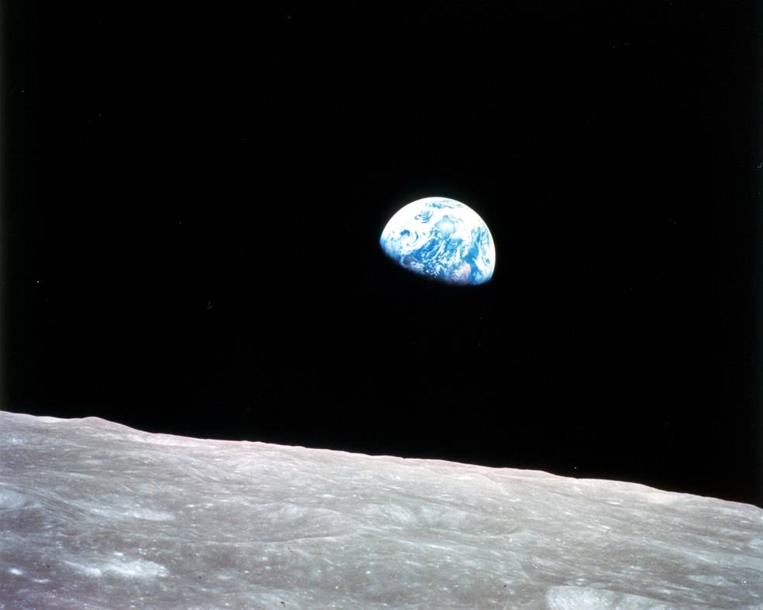
https://ares.jsc.nasa.gov/interaction/lmdp/
Discoveries From Apollo Lunar Samples
How the Moon Formed
Earth’s Early History
Early history of impacts in the inner Solar System
Image Credits: (left) courtesy of William K. Hartmann
NASA 297755
Notes:
(Left)-This is a painting by artist and planetary scientist William Hartmann depicting the way most scientists believe the Moon formed. Because all the traditional ideas for Lunar origin had fatal flaws, Hartmann and other scientists devised the idea that the Moon formed as a result of the impact of a small planet-sized projectile with the early Earth. Both the projectile and Earth already had formed metallic cores and computer simulations of the giant impact indicate that the core of the projectile gets added to Earth’s iron core, thus accounting for the fact that the Moon has a tiny iron core. Much of the rocky mantles of the Earth and projectile melted or vaporized. The material that ended up in orbit around the Earth then accreted to form the Moon. (Photography courtesy of William K. Hartmann.)
(right)- Earth’s early history (the first 600 million years) can be studied through ancient lunar samples. This is because the Earth’s crust is recycled through plate tectonics and weathering. The photo is from Apollo 8, 1968. (NASA 297755)

Slide 20
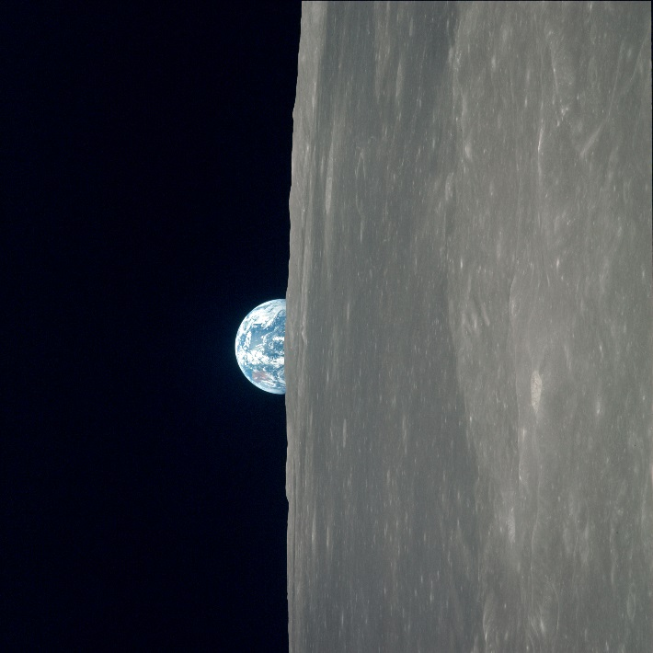
Discoveries
Lunar samples are > 4 billion years old and preserve the early history of the solar system.
Studies provide an understanding of Earth’s early history.
Lunar samples record impact history and led scientist to conclude that the gas giants did not form where they are today.
The Moon is not completely dry.
Image Credits: NASA
https://ares.jsc.nasa.gov/interaction/lmdp/
Notes:
These are some of the discoveries from the Apollo missions. Go to http://solarsystem.nasa.gov/missions/target/moon and http://ares.jsc.nasa.gov to find more information on missions to the Moon and their discoveries.
More information: https://curator.jsc.nasa.gov/lunar/index.cfm and https://moon.nasa.gov/home.cfm

Slide 21
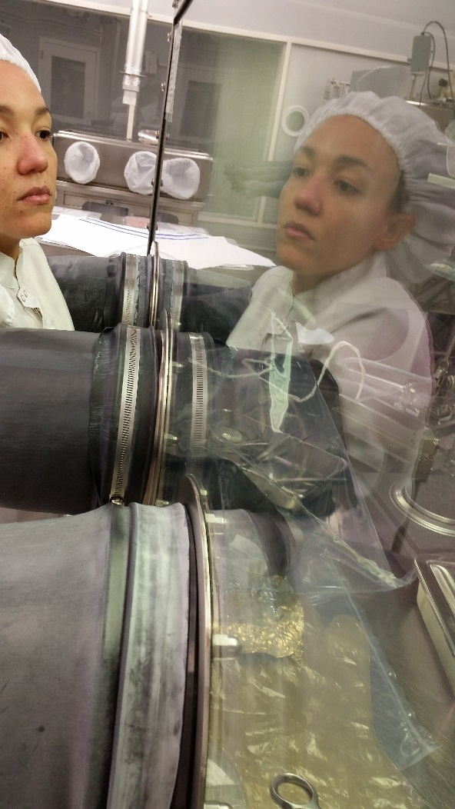

More Information
National Aeronautics and Space Administration
More information can be found at:
https://ares.jsc.nasa.gov/
And
https://ares.jsc.nasa.gov/interaction/lmdp/
Image Credits: NASA

